Slide 1

Lecture 5: CSS Foundation
Open Source Web Software

Slide 2
In the last lecture
HTML multimedia elements
audio and video elements
HTML blocks
Block elements
<h1> ~ <h6>, <p>, <hr>, <ul>, <ol>, <li>, <table>, <div>
Inline elements
<a>, <img>, <b>, <strong>, <i>, <em>, <sub>, <sup>, <span>, <label>
HTML input elements
Various <input> elements

Slide 3
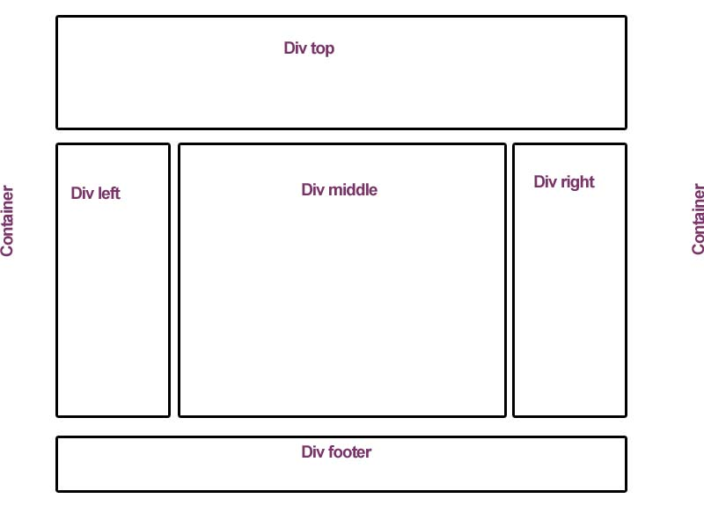
In the last lecture
<div>
Stands for “divide“ and is used for divide the page into logical sections
Tip: Very often used together with CSS, to layout a web page

Slide 4
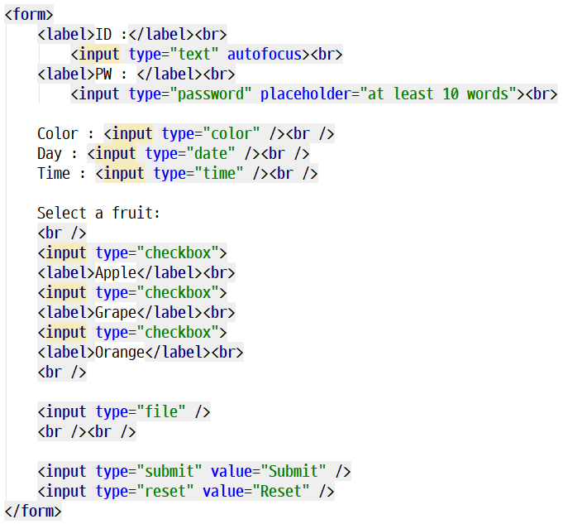
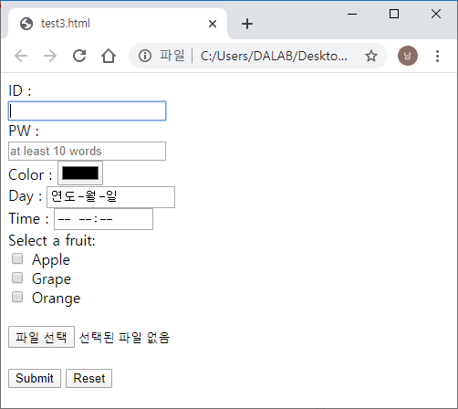
In the last lecture
Practice

Slide 5
Table of Contents
Part 3.
CSS Properties
Part 4.
Practice
Part 1.
CSS Basics
Part 2.
CSS Insertion

Slide 6
CSS Basics
PART 1

Slide 7
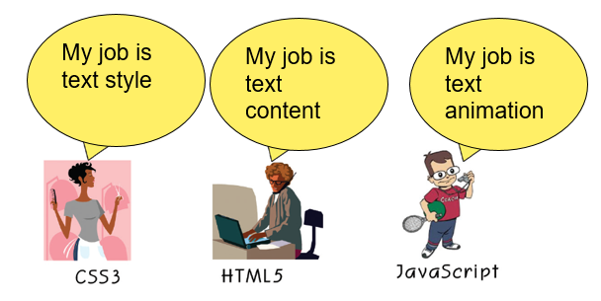
CSS Basics
Web Development
Website structure -> HTML
Website style ->CSS

Slide 8
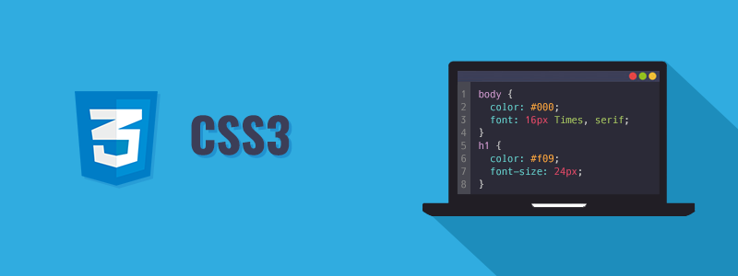
CSS Basics
What is CSS?
Cascading Style Sheets

Slide 9
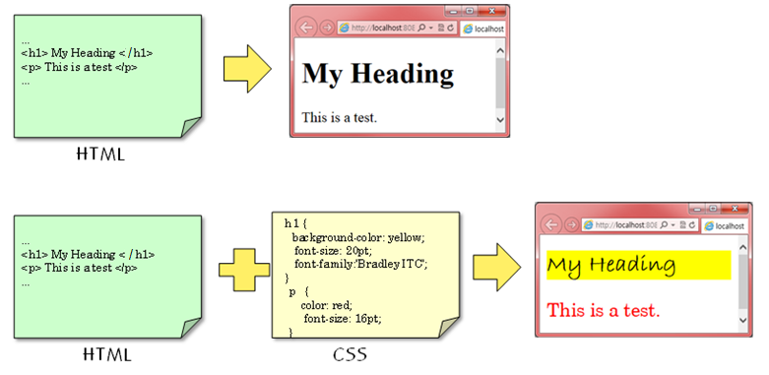
CSS Basics
What is CSS?
Defines style of text

Slide 10

CSS Basics
What is CSS?
If there is no CSS then:

Slide 11
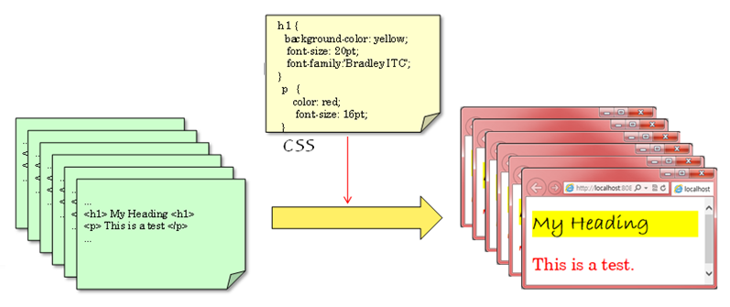
CSS Basics
Why CSS?
All pages share the same CSS
Changing the style in CSS changes contents of all involved pages

Slide 12
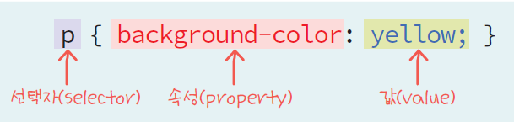
CSS Basics
CSS3 syntax
Selector { property: value; }
Should have ; at the end
comment: /* … */

Slide 13
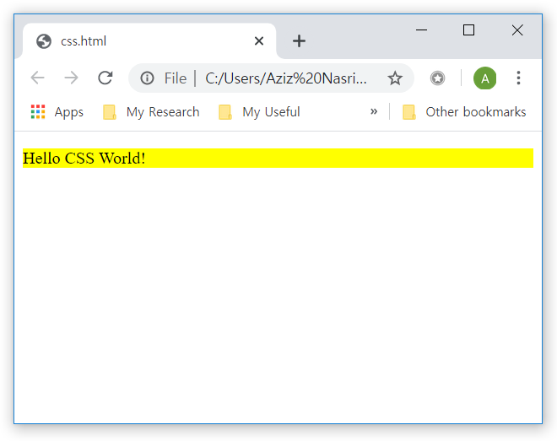
CSS Basics
CSS
Example
<!DOCTYPE html>
<html>
<head>
…
<style>
p { background-color: yellow; }
</style>
</head>
<body>
<p>Hello CSS World!</p>
</body>
</html>

Slide 14
CSS Selectors
What is CSS Selector?
Used to "find" (or select) the HTML elements you want to style
CSS Selectors
Type selector
Universal selector
ID and Class selectors
Attribute selector
Pseudo-class selector

Slide 15
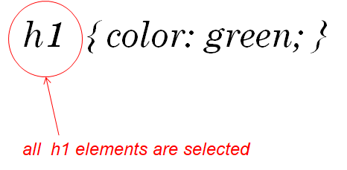
CSS Selectors
Type selector
HTML element name used

Slide 16
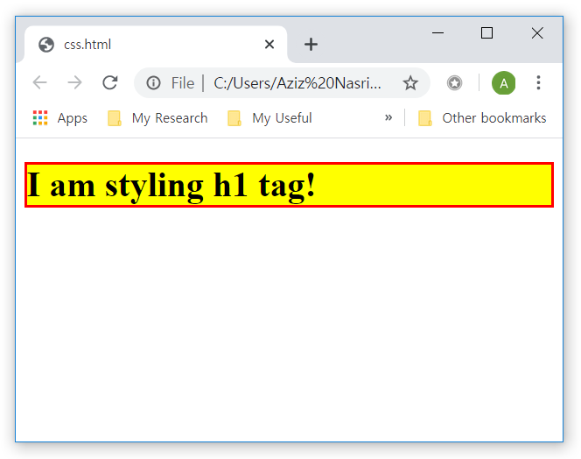
CSS Basics
Type selector
Example
<!DOCTYPE html>
<html>
<head>
…
<style>
h1 {
background-color: yellow;
border: 2px solid red;
}
</style>
</head>
<body>
<h1>I am styling h1 tag!</h1>
</body>
</html>

Slide 17
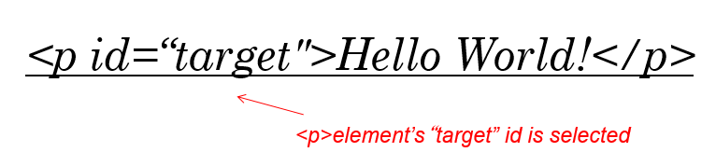
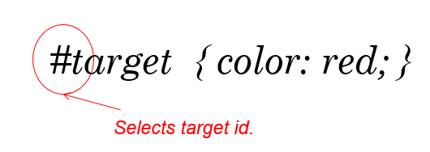
CSS Selectors
ID selector
Select a specific element with ID attribute
The ID of an element is unique within a HTML page
So the ID selector is used to select one unique element

Slide 18
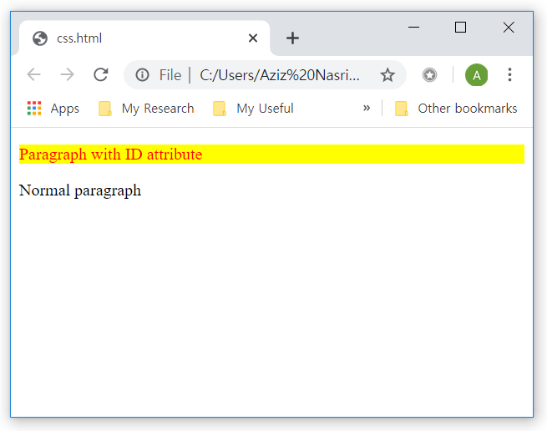
CSS Selectors
ID selector
Example
<!DOCTYPE html>
<html>
<head>
…
<style>
#special {
background-color: yellow;
color: red;
}
</style>
</head>
<body>
<p id="special">Paragraph with ID
attribute</p>
<p>Normal paragraph</p>
</body>
</html>

Slide 19
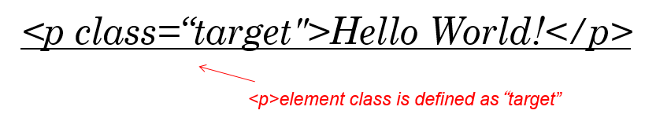
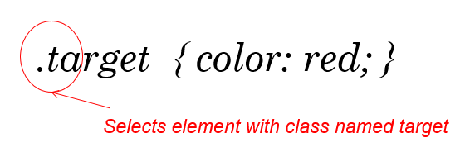
CSS Selectors
Class selector
Select a specific element with ‘class’ target
The difference between an ID and a class
ID can be used to identify one element, whereas a class can be used to identify more than one

Slide 20
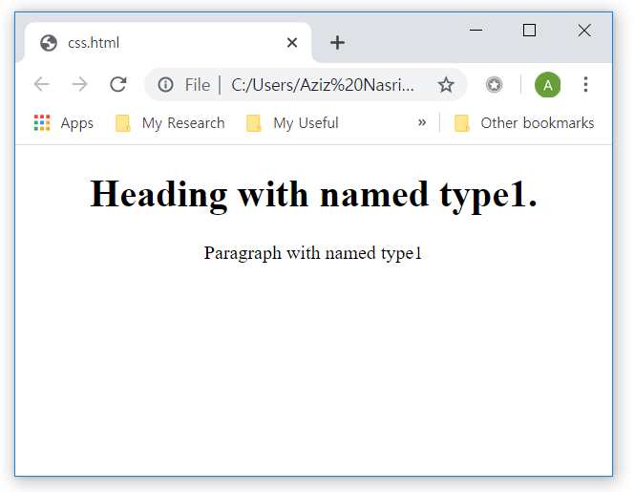
CSS Selectors
Class selector
Example
<!DOCTYPE html>
<html>
<head>
<meta charset="utf-8">
<title></title>
<style>
.type1 {
text-align: center;
}
</style>
</head>
<body>
<h1 class="type1">Heading with
named type1.</h1>
<p class="type1">Paragraph with
named type1</p>
</body>
</html>

Slide 21
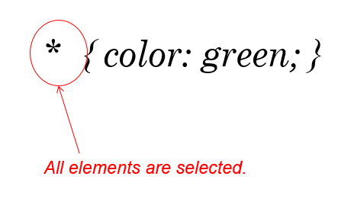
CSS Selectors
Universal selector
Selects all elements inside the page

Slide 22
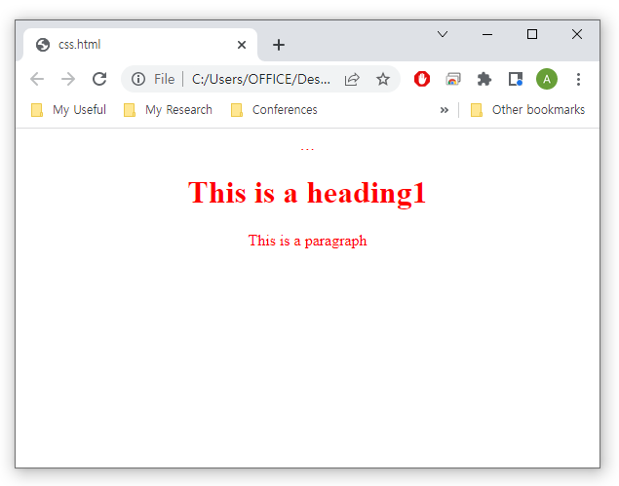
CSS Selectors
Universal selector
Example
<!DOCTYPE html>
<html lang="en" dir="ltr">
<head>
…
<style>
*{
text-align: center;
color: red;
}
</style>
</head>
<body>
<h1>This is a heading1</h1>
<p>This is a paragraph</p>
</body>
</html>

Slide 23
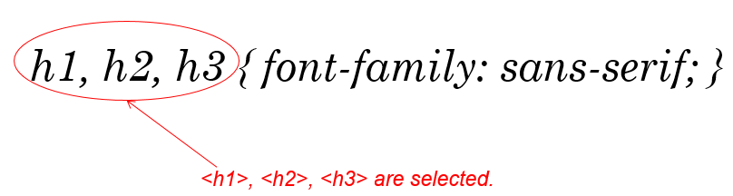
CSS Selectors
CSS Grouping Selector
A CSS selector can contain more than one simple selector
There are several types of CSS combinators
Simple combinatory (comma)
Descendant selector (space)
Child selector (>)
Adjacent sibling selector (+)
General sibling selector (~)

Slide 24
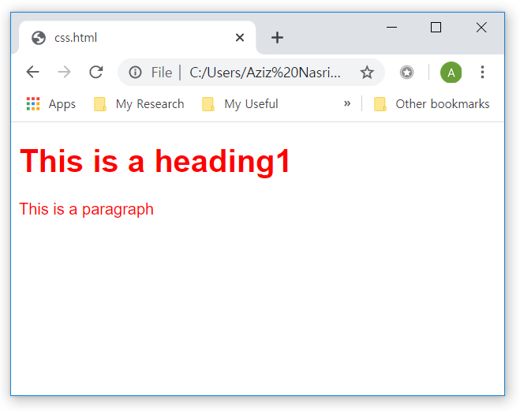
CSS Selectors
CSS Grouping Selector
Example
<!DOCTYPE html>
<html lang="en" dir="ltr">
<head>
…
<style>
h1, p {
font-family: sans-serif;
color: red;
}
</style>
</head>
<body>
<h1>This is a heading1</h1>
<p>This is a paragraph</p>
</body>
</html>

Slide 25
CSS Selectors
Attribute selector
Selects an element with a specific attribute
Example
h1[title] { color: blue; }
p[class=“example”] { color: blue; }
Check out more information about attribute selector
https://www.w3schools.com/css/css_attribute_selectors.asp

Slide 26
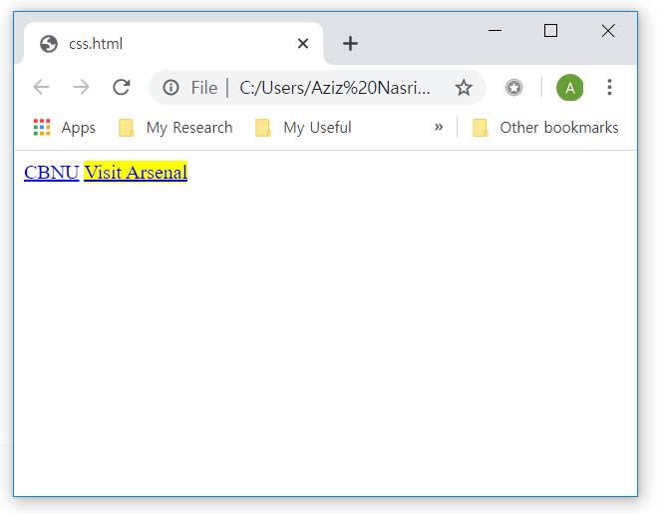
CSS Selectors
Attribute selector
Example
<!DOCTYPE html>
<html lang="en" dir="ltr">
<head>
…
<style>
a[target=_blank] {
background-color: yellow;
}
</style>
</head>
<body>
<a href="https://www.chungbuk.ac.kr">CBNU</a>
<a href="http://www.arsenal.com" target="_blank">Visit Arsenal</a>
</body>
</html>

Slide 27
CSS Selectors
Pseudo-class selector
Used to define a special state of an element
Syntax
selector:pseudo-class {
property:value;
}
Where used?
Style an element when a user mouses over it
Style visited and unvisited links differently
Style an element when it gets focus

Slide 28
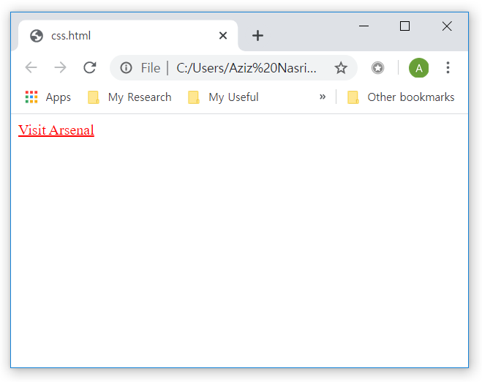
CSS Selectors
Pseudo-class selector
Example
<style>
/* unvisited link */
a:link {
color: red;
}
/* visited link */
a:visited {
color: green;
}
/* mouse over link */
a:hover {
color: hotpink;
}
/* selected link */
a:active {
color: blue;
}
</style>

Slide 29
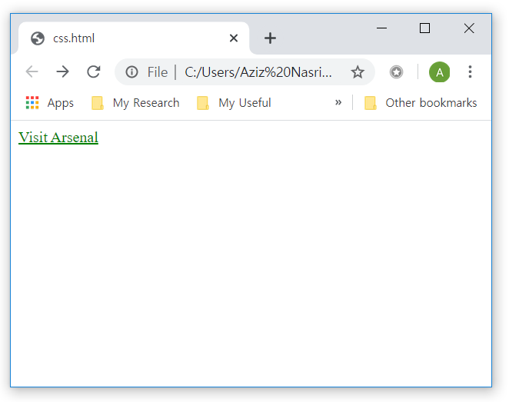
CSS Selectors
Pseudo-class selector
Example
<style>
/* unvisited link */
a:link {
color: red;
}
/* visited link */
a:visited {
color: green;
}
/* mouse over link */
a:hover {
color: hotpink;
}
/* selected link */
a:active {
color: blue;
}
</style>

Slide 30
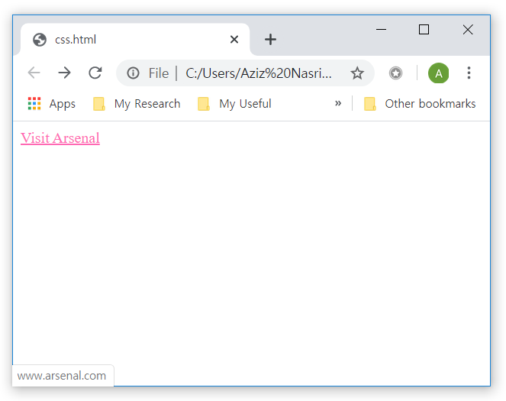

CSS Selectors
Pseudo-class selector
Example
<style>
/* unvisited link */
a:link {
color: red;
}
/* visited link */
a:visited {
color: green;
}
/* mouse over link */
a:hover {
color: hotpink;
}
/* selected link */
a:active {
color: blue;
}
</style>
Changes to hotpink whenever
you put mouse over link

Slide 31
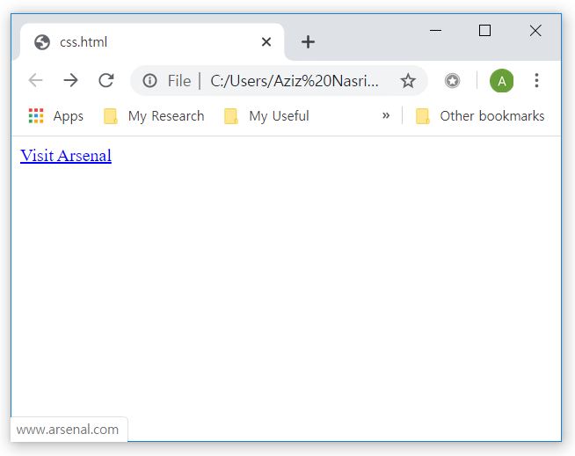
CSS Selectors
Pseudo-class selector
Example
<style>
/* unvisited link */
a:link {
color: red;
}
/* visited link */
a:visited {
color: green;
}
/* mouse over link */
a:hover {
color: hotpink;
}
/* selected link */
a:active {
color: blue;
}
</style>
Changes to blue when you
keep clicking on the link

Slide 32
CSS Insertion
Part 2

Slide 33
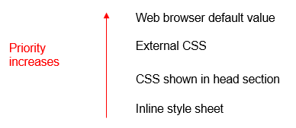
CSS Insertion
There are three ways of connecting CSS with your HTML document
external style sheet
internal style sheet
Inline
If you specify different external, internal, and inline styles for an element, which style will be used?

Slide 34
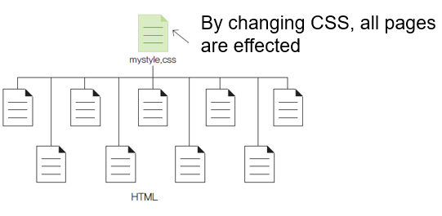
CSS Insertion
External style sheet
Stores a style sheet as an external file
A good way to apply the same style to many pages
Syntax
<link type="text/css" rel="stylesheet" href="mystyle.css">

Slide 35
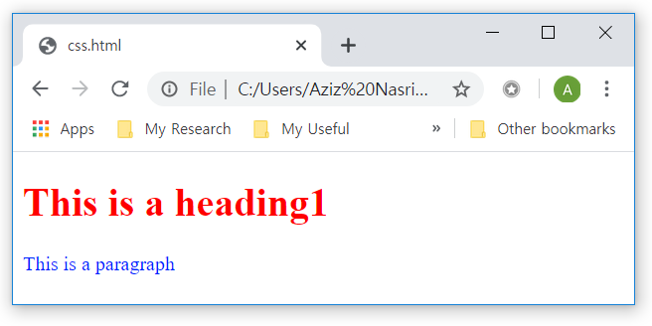
CSS Insertion
External style sheet
mystyle.css
h1 { color: red; }
p { color:#0026ff; }
<!DOCTYPE html>
<html lang="en" dir="ltr">
<head>
<link type="text/css" rel="stylesheet" href="mystyle.css">
</head>
<body>
<h1>This is a heading1</h1>
<p>This is a paragraph</p>
</body>
</html>

Slide 36
CSS Insertion
Internal style sheet
Placed inside of HTML document <style> tag
<!DOCTYPE html>
<html lang="en" dir="ltr">
<head>
<style>
h1 { color: red; }
p { color:#0026ff; }
</style>
</head>
<body>
<h1>This is a heading1</h1>
<p>This is a paragraph</p>
</body>
</html>

Slide 37
CSS Insertion
Inline CSS
Specifies styles for each HTML element
Note* if there are two or more properties, write “;” at the end.
<!DOCTYPE html>
<html lang="en" dir="ltr">
<head>
...
</head>
<body>
<h1 style="color: red">This is a heading1</h1>
<p style="color: #0026ff">This is a paragraph</p>
</body>
</html>

Slide 38
CSS Properties
Part 3

Slide 39
CSS Properties
Types of CSS properties
CSS Background
CSS Text
CSS Font
CSS Table
CSS List

Slide 40
CSS properties
CSS background
Used to define the background effects for elements
Property | Description
background | Define all background properties in one line.
background-attachment | Specifies whether the background image is fixed or scrolled.
background-color | Define the background color.
background-image | Define background image.
background-position | Specifies the start position of the background image.
background-repeat | Specifies whether to repeat the background image.
body { background-color: red; } /* Set background to red */
body { background-color: rgb(255,0,0); } /* Set background to red */
body { background-color: #ff0000; } /* Set background to red */

Slide 41

CSS properties
Background color
Method | Description
Express by text | “red“
Express hexadecimals | #FF0000
Express by 10 digits | rgb(255, 0, 0)
Express by percent | rgb(100%, 0%, 0%)

Slide 42
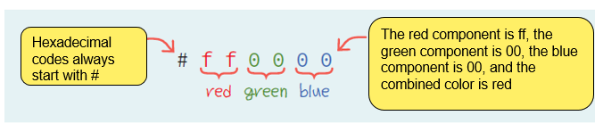
CSS properties
Background color
A hexadecimal code is a two-digit hexadecimal representation of the red, green, and blue values, respectively.
body
{
background-color: #ffd800;
}

Slide 43
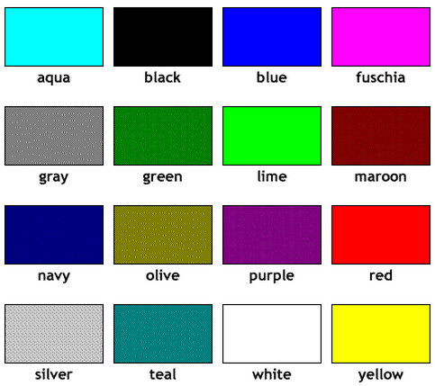
CSS properties
Background color
You can express colors by their name
body
{
background-color: aqua;
}

Slide 44
CSS properties
Background color
Expressing colors by RGB
body
{
background-color: rgb(60%, 40%, 10%);
}
body
{
background-color: rgb(153, 102, 25);
}

Slide 45
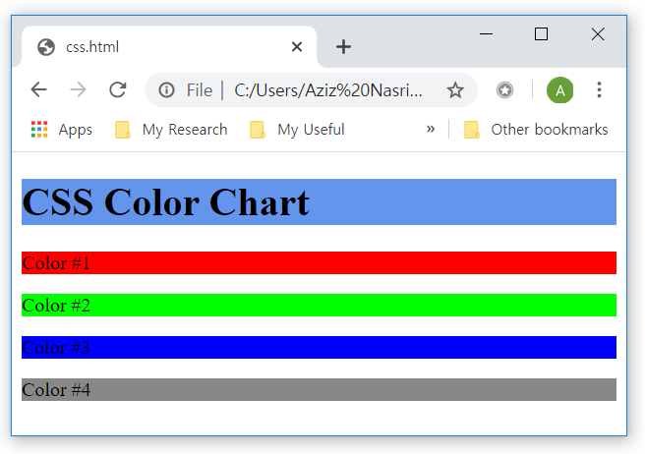
CSS properties
<!DOCTYPE html>
<html>
<head>
<style>
h1 { background-color: #6495ed; }
p.a { background-color: #ff0000; }
p.b { background-color: #00ff00; }
p.c { background-color: #0000ff; }
p.d { background-color: #888888; }
</style>
</head>
<body>
<h1>CSS Color Chart</h1>
<p class="a">Color #1</p>
<p class="b">Color #2</p>
<p class="c">Color #3</p>
<p class="d">Color #4</p>
</body>
</html>

Slide 46
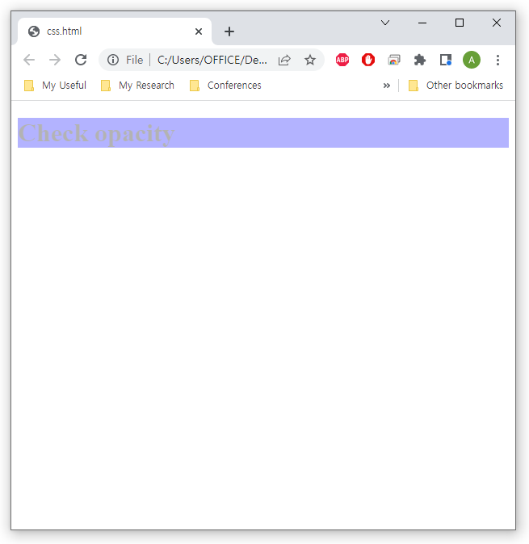
CSS properties
Background color
The opacity property specifies the opacity/transparency of an element
<!DOCTYPE html>
<html>
<head>
<style>
div {
background-color: blue;
opacity: 0.3;
}
</style>
</head>
<body>
<div>
<h1>Check opacity</h1>
</div>
</body>
</html>

Slide 47
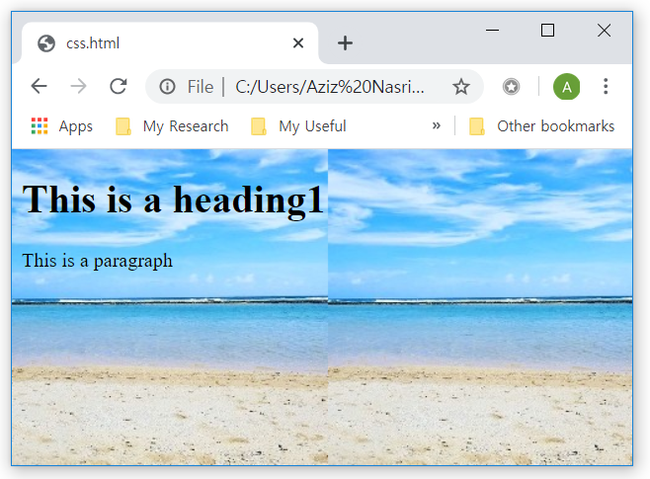
CSS properties
Background image
The background-image property specifies an image to use as the background of an element
<!DOCTYPE html>
<html>
<head>
<style>
body {
background-image: url('back.jpg')
}
</style>
</head>
<body>
<h1>This is a heading1</h1>
<p>This is a paragraph</p></body>
</html>

Slide 48
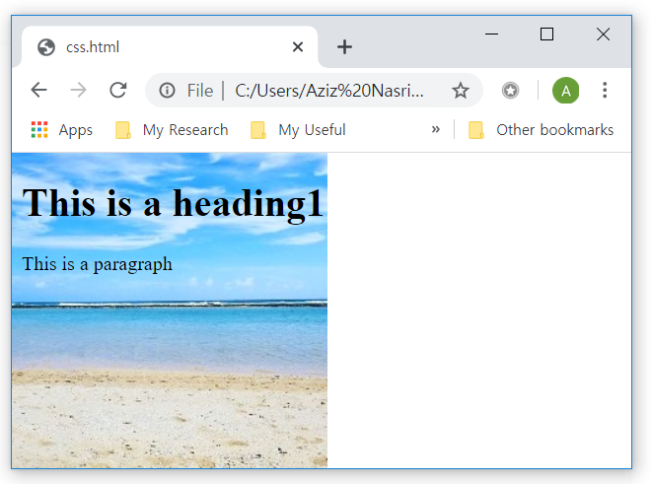
CSS properties
Background repeat
The background-repeat property sets if/how a background image will be repeated
<!DOCTYPE html>
<html>
<head>
<style>
body {
background-image: url('back.jpg');
background-repeat: no-repeat;
}
</style>
</head>
<body>
<h1>This is a heading1</h1>
<p>This is a paragraph</p></body>
</html>

Slide 49
CSS properties
Background attachment
The background-attachment property specifies whether the background image should scroll or be fixed
<!DOCTYPE html>
<html>
<head>
<style>
body {
background-image: url('back.jpg');
background-repeat: no-repeat;
background-attachment: fixed;
}
</style>
</head>
<body>
<h1>This is a heading1</h1>
<p>This is a paragraph</p></body>
</html>

Slide 50
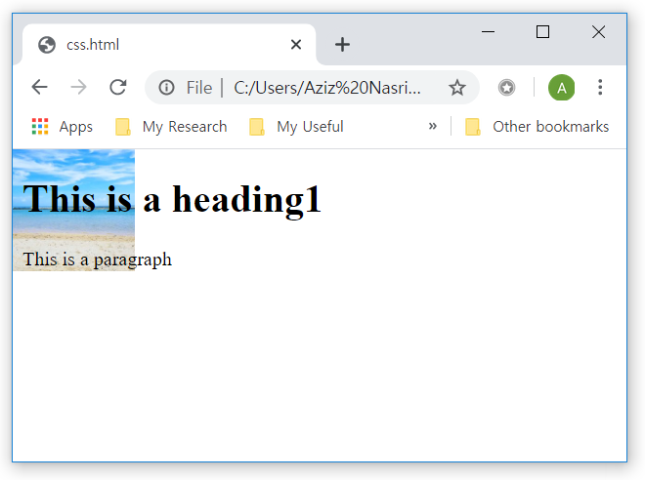
CSS properties
Background size
The background-size property specifies the size of the background images
<!DOCTYPE html>
<html>
<head>
<style>
body {
background-image: url('back.jpg');
background-repeat: no-repeat;
background-size: 100px 100px;
}
</style>
</head>
<body>
<h1>This is a heading1</h1>
<p>This is a paragraph</p></body>
</html>

Slide 51
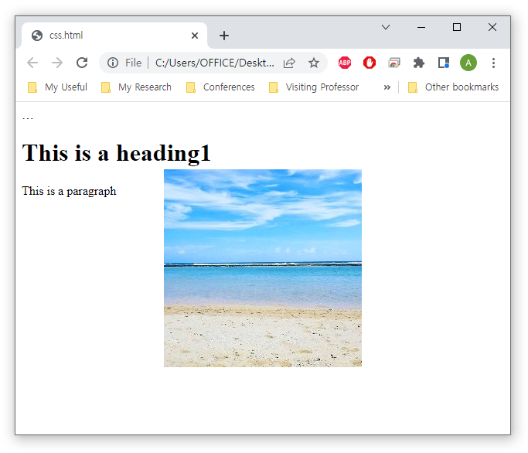
CSS properties
Background position
The background-position property sets the starting position of a background image
<!DOCTYPE html>
<html>
… <style>
body {
background-image: url('back.jpg');
background-repeat: no-repeat;
background-attachment: fixed;
background-position: center;
}
</style>
</head>
<body>
<h1>This is a heading1</h1>
<p>This is a paragraph</p></body>
</html>

Slide 52
CSS properties
Background shorthand
To shorten the code, it is also possible to specify all the background properties in one single property
When using the shorthand property the order of the property values is:
background-color
background-image
background-repeat
background-attachment
background-position

Slide 53
CSS properties
Background shorthand
Example
<!DOCTYPE html>
<html>
… <style>
body {
background: url('back.jpg') no-repeat fixed center;
}
</style>
</head>
<body>
<h1>This is a heading1</h1>
<p>This is a paragraph</p></body>
</html>

Slide 54
CSS properties
CSS text
Used to define the various effects for text
Property | Description
color | Specifies the color of the text.
direction | Specifies the text direction. (Horizontal writing, vertical writing)
letter-spacing | Specify the spacing between characters.
line-height | Specifies the height of the text line.
text-align | Specifies the horizontal alignment of the text.
text-decoration | Specify text decoration.
text-indent | Specifies the indentation of the text.
text-shadow | Specify a shadow effect.
text-transform | Specifies case conversion.

Slide 55
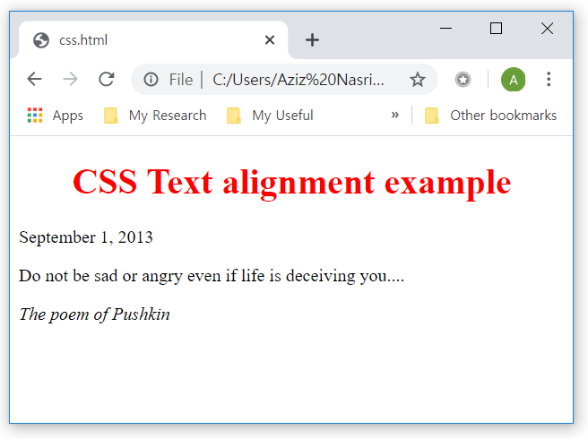
CSS properties
Text alignment
The text-align property is used to set horizontal alignment of a text
<!DOCTYPE html>
<html>
<head>
<style>
h1 { text-align: center; color: red; } // center alignment
p.date { text-align: right; color: indigo; } // right alignment
p.poet { text-align: justify; color: blue; } // left alignment
</style>
</head>
<body>
<h1>CSS Text alignment example </h1>
<p class="date">September 1, 2013 </p>
<p class="poet">Do not be sad or angry even if life is deceiving you....</p>
<p><em> The poem of Pushkin </em> </p>
</body>
</html>

Slide 56
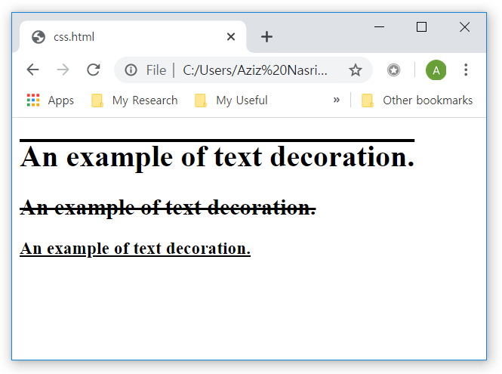
CSS properties
Text decoration
The text-decoration-line property adds a decoration line to text
<!DOCTYPE html>
<html>
<head>
<style>
h1 { text-decoration-line: overline; }
h2 { text-decoration-line: line-through; }
h3 { text-decoration-line: underline; }
</style>
</head>
<body>
<h1> An example of text decoration. </ h1> <h2> An example of text decoration. </ h2> <h3> An example of text decoration. </ h3>
</body>
</html>

Slide 57
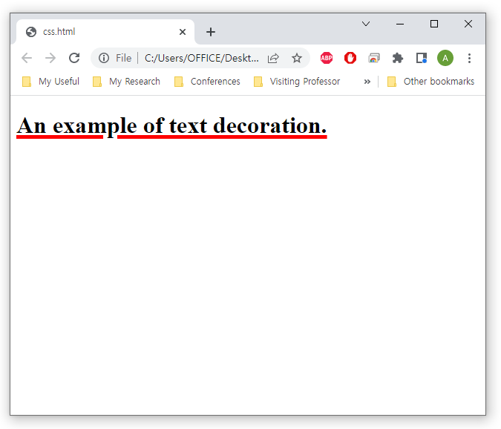
CSS properties
Text decoration
The text-decoration property is a shorthand property
<!DOCTYPE html>
<html>
<head>
<style>
h1 { text-decoration: underline red 5px; }
</style>
</head>
<body>
<h1> An example of text decoration. </ h1> </body>
</html>

Slide 58
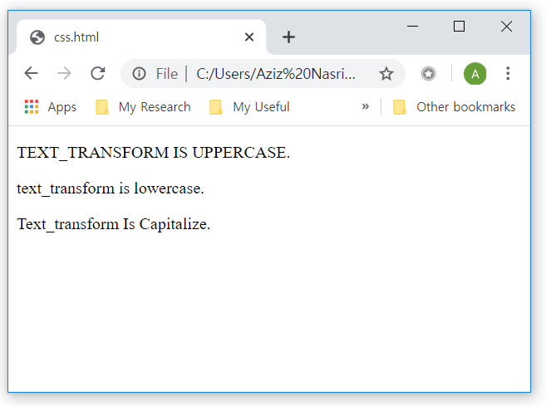
CSS properties
Text transformation
The text-transform property specifies transformations in a text
<!DOCTYPE html>
<html>
<head>
<style>
p.upper { text-transform: uppercase; }
p.lower { text-transform: lowercase; }
p.capit { text-transform: capitalize; }
</style>
</head>
<body>
<p class="upper">text_transform is uppercase.</p>
<p class="lower">text_transform is lowercase.</p>
<p class="capit">text_transform is capitalize.</p>
</body>
</html>

Slide 59
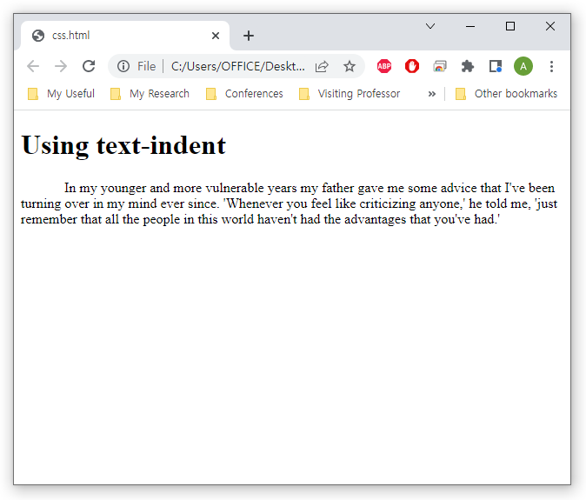
CSS properties
Text Indent
The text-indent property specifies indentation of the first line of a text
<!DOCTYPE html>
<html>
…<style>
p {
text-indent: 50px;
}
</style>
</head>
<body>
<h1>Using text-indent</h1>
<p>In my younger and more vulnerable years my father gave me some advice that I've been turning over in my mind ever since. 'Whenever you feel like criticizing anyone,' he told me, 'just remember that all the people in this world haven't had the advantages that you've had.'</p>
</body>
</html>

Slide 60
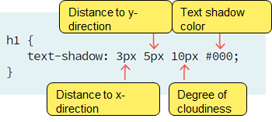
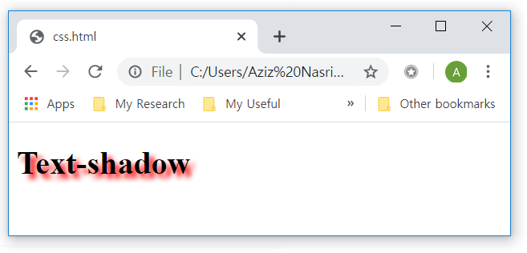
CSS properties
Text shadow
The text-shadow property adds shadow to text
<!DOCTYPE html>
<html>
<head>
<style>
h1 {
text-shadow: 5px 5px 5px #FF0000;
}
</style>
</head>
<body>
<h1>Text-shadow</h1>
</body>
</html>

Slide 61
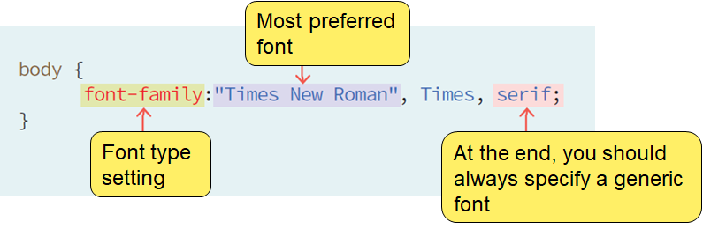
CSS properties
CSS font
Define the font family, boldness, size, and the style of a text.
Property | Description
font | Used to set all font attributes in one line
font-family | Font Family Settings
font-size | Set font size
font-style | Set font style
font-weight | Set whether the font is bold

Slide 62
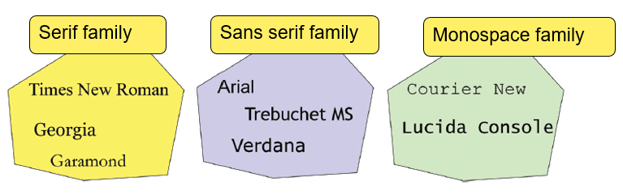
CSS properties
Font family
serif font has an elegant and traditional feel
sans-serif is clean and readable.
monospace typewriter font
the cursive and fantasy fonts are funny and stylish

Slide 63
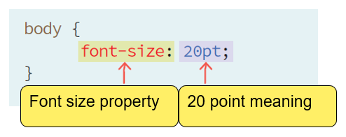
CSS properties
Units of font
pt – points
px - pixel
% - percent
keyword – xx-small, x-small, small, medium, large, x-large, xx-large
em – scale factor
1em is equal to the 16px
vw - viewport width (responsive font size)

Slide 64
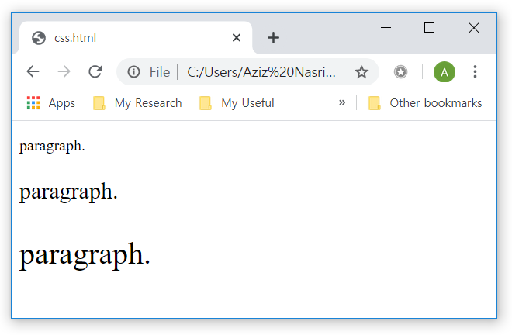
CSS properties
Font size
Example
<!DOCTYPE html>
<html>
<head>
<style>
body { font-size: medium; }
p#t1 { font-size: 1.0em; }
p#t2 { font-size: 1.5em; }
p#t3 { font-size: 2.0em; }
</style>
</head>
<body>
<p id="t1">paragraph.</p>
<p id="t2">paragraph.</p>
<p id="t3">paragraph.</p>
</body>
</html>

Slide 65
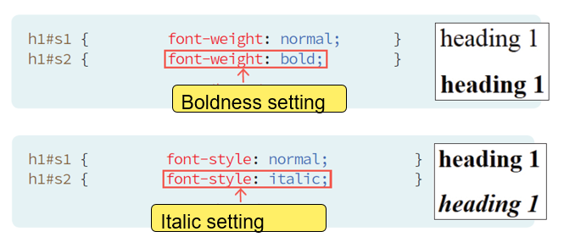
CSS properties
Font property
font-weight – boldness (normal, bold)
font-style – italic (normal, italic, oblique)

Slide 66
CSS properties
Font shorthand
To shorten the code, it is also possible to specify all the individual font properties in one property
The font property is a shorthand property
font-style
font-variant
font-weight
font-size/line-height
font-family
Note that the font-size and font-family values are required

Slide 67
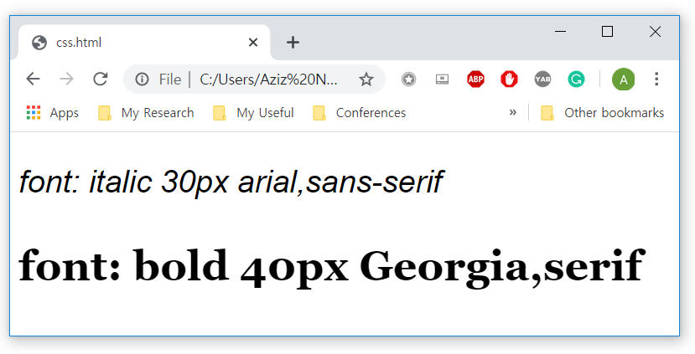
CSS properties
Font property
Example
<!DOCTYPE html>
<html>
<head>
<style>
p.style1 {
font: italic 30px arial, sans-serif;
}
p.style2 {
font: bold 40px Georgia, serif;
}
</style>
</head>
<body>
<p class="style1">font: italic 30px arial,sans-serif</p>
<p class="style2">font: bold 40px Georgia,serif</p>
</body>
</html>

Slide 68
CSS properties
CSS table
Define the classes for decorating tables
Property | Description
border | Table boundary
border-collapse | Whether to merge the boundaries of neighboring cells
width | The width of the table
height | The height of the table
border-spacing | Distance between table cells
empty-cells | Whether to draw a blank cell
table-align | Alignment of table cells

Slide 69

CSS properties
<!DOCTYPE html>
<html>
<head>
<style>
table, td, th {
border: 1px solid blue;
}
</style>
</head>
<body>
<table>
<tr>
<th>name</th>
<th>email</th>
</tr>
<tr>
<td>Mark Twain</td>
<td>mark@google.com</td>
</tr>
<tr>
<td>Mark Young</td>
<td>young@google.com</td>
</tr>
</table>
</body>
</html>

Slide 70

CSS properties
Boundary integration
collapse: Combines the boundaries of neighboring cells and displays them as a single line.
<!DOCTYPE html>
<html>
<head>
<style>
table {
border-collapse: collapse;
}
table, th, td {
border: 1px solid blue;
}
</style>
…

Slide 71
CSS properties
Boundary integration
separate: Separate and display adjacent cell boundary lines together.
<!DOCTYPE html>
<html>
<head>
<style>
table {
border-collapse: separate;
}
table, th, td {
border: 1px solid blue;
}
</style>
…

Slide 72

CSS properties
<!DOCTYPE html>
<html>
<head>
<style>
td, th {
color: white;
background-color: green;
}
</style>
</head>
<body>
<table>
<tr>
<th> name </th>
<th> email </th>
</tr>
<tr>
<td> Mark Twain </td>
<td> mark@google.com </td>
</tr>
<tr>
<td> Mark Young </td>
<td> young@google.com </td>
</tr>
</table>
</body>
</html>

Slide 73

CSS properties
Table color
Separation of header and data
<!DOCTYPE html>
<html>
<head>
<style>
table, td, th {
border: 1px solid green;
}
th {
background-color: green;
color: white;
}
</style>
</head>
…

Slide 74

CSS properties
<!DOCTYPE html>
<html>
<head>
<style>
table, td, th { border: 1px solid blue; }
table { width: 100%; }
td { text-align: center; }
th { height: 50px; }
</style>
</head>
<body>
<table>
<tr>
<th> name </th>
<th> email </th>
</tr>
<tr>
<td> Mark Twain </td>
<td> mark@google.com </td>
</tr>
<tr>
<td> Mark Young </td>
<td> young@google.com </td>
</tr>
</table>
</body>
</html>
The width and height of a table are defined by the width and height properties

Slide 75

CSS properties
<!DOCTYPE html>
<html>
<head>
<style>
caption { caption-side: top; }
</style>
</head>
<body>
<table border="1">
<caption>Authors List</caption>
<tr>
<th> name </th>
<th> email </th>
</tr>
<tr>
<td> Mark Twain </td>
<td> mark@google.com </td>
</tr>
<tr>
<td> Mark Young </td>
<td> young@google.com </td>
</tr> </table>
</body>
</html>

Slide 76

CSS properties
<!DOCTYPE html>
<html>
<head>
<style>
table { width: 100%; }
th, td { padding: 8px; text-align: left; border-bottom: 1px solid #ddd; }
</style>
</head>
<body>
<table>
<tr>
<th> name </th>
<th> email </th>
</tr>
<tr>
<td> Mark Twain </td>
<td> mark@google.com </td>
</tr>
<tr>
<td> Mark Young </td>
<td> young@google.com </td>
</tr>
</table>
</body>
</html>

Slide 77

CSS properties
CSS Lists
The CSS list properties allow you to:
Set different list item markers for ordered lists
Set different list item markers for unordered lists
Set an image as the list item marker
Add background colors to lists and list items

Slide 78

CSS properties
CSS Lists
The list-style-type property specifies the type of list item marker
The list-style-type:none property can also be used to remove the markers/bullets
ul.a {
list-style-type: circle;
}
ul.b {
list-style-type: square;
}
ol.c {
list-style-type: upper-roman;
}
ol.d {
list-style-type: lower-alpha;
}

Slide 79
Summary and Discussions
CSS Basics
What is CSS?
Cascading Style Sheets
Defines style of text
Why CSS?
All pages share the same CSS
CSS3 syntax
Selector { property: value; }
Should have ; at the end

Slide 80
Summary and Discussions
CSS Selectors
What is CSS Selector?
Used to "find" (or select) the HTML elements you want to style
CSS Selectors
Type selector
Universal selector
ID and Class selectors
Attribute selector
Pseudo-class selector
CSS combinator
A CSS selector can contain more than one simple selector

Slide 81
Summary and Discussions
CSS Insertions
There are three ways of connecting CSS with your HTML document
external style sheet
internal style sheet
Inline
If you specify different external, internal, and inline styles for an element, which style will be used?

Slide 82
Summary and Discussions
CSS Properties
CSS Background
CSS Text
CSS Font
CSS Table
CSS Lists

Slide 83
Practice
Part 4

Slide 84
CSS Selectors
What is CSS Selector?
Used to "find" (or select) the HTML elements you want to style
CSS Selectors
Type selector
Universal selector
ID and Class selectors
Attribute selector
Pseudo-class selector

Slide 85

CSS Selectors
Practice 1
How to use various selectors (universal and type selectors)
selectors(1).html

Slide 86


CSS Selectors
Practice 2
How to use various selectors (id, class and pseudo-class selectors)
selectors(2).html

Slide 87


CSS Selectors
Task 1
Use ID and Class selectors
Use pseudo-class selectors
ID selector
Class selector
When mouse over, link color
changes to blue

Slide 88

CSS Insertion
Practice 3
Check out priority of various CSS insertions

Slide 89

CSS Properties
Practice 4
How to use background color and image

Slide 90


CSS Properties
Task 2
When mouse is over the image, it must become a bit transparent
More fancy examples
https://www.w3schools.com/css/css3_images.asp

Slide 91

CSS Properties
Practice 5
Playing with different fond styling properties

Slide 92

CSS Properties
Practice 6
Playing with various text decoration properties

Slide 93

CSS Properties
Task 3
When Web Programming is active, it must show the shadow
When p tag is hovered, the text must be changed to bold text

Slide 94

CSS Properties
Practice 7

Slide 95

CSS Properties
Practice 8

Slide 96


CSS Properties
CSS Tables
You can use nth-child(n) pseudo-class to change the color of the table rows
properties(6).html

Slide 97

CSS Properties
Task 4
Change the color of rows when mouse is over them

Slide 98

CSS Properties
Task 5

Slide 99
Homework for Lecture 5
Include the following CSS tasks to the personal website you created in Lecture 4
Create three types of CSS insertions (inline, inside of head, external CSS)
Include the following properties
CSS Background
CSS Text
CSS Font
CSS Table
CSS List
Use at least three types of CSS selectors
Make sure that your personal website looks attractive
Create a ZIP folder that includes all necessary source code files
Deadline: April 1, 2022 12:59

Slide 100
See you next time!
Questions?

